Slide 1
Intermediate Analytics ALY6015 Lecture 5: Time Series and Forecasting

Slide 2
Welcome! Today’s Agenda
Administrative Notes
Lecture – Part 1
<BREAK>
Lecture – Part 2
Assignment #5 Overview
Group Project Overview
Notes:
.

Slide 3
Administrative Notes
Grading philosophy
Presentations next week

Slide 4
Course Tracker
Descriptive statistics in R (Week 1)
Graphical representation of data in R (Week 1)
Inferential statistics in R (Week 2)
Hypothesis testing (Week 2)
Regression Analysis (Week 2)
Regularization and Lasso Modeling (Week 3)
Data Mining (Week 4)
Clustering and Classification (Week 4)
Time Series Forecasting (TODAY)
Bringing it all together – Group Project (Week 6)

Slide 5
Lecture Part 1

Slide 6
What is Time Series and Forecasting?
**Definition** Time series is an ordered sequence of values of a variable at equally spaced time intervals. Time series analysis accounts for the fact that data points taken over time may have an internal structure (such as autocorrelation, trend or seasonal variation) that should be accounted for.
**Forecasting** is the process of predicting a future event.

Slide 7
Time Series
**Use**:
Obtain an understanding of the underlying forces and structure that produced the observed data
Fit a model and proceed to forecasting, monitoring or even feedback and feedforward control.
**Application**
Economic Forecasting
Stock Market Analysis
Sales Forecasting
Budgetary Analysis
Quality Control
Workload Projections

Slide 8
Forecasting Approaches
**Qualitative Methods**: used when situation is vague & little data exist such as new product or new technology. Primary method is intuition and past experience. Example, is market research, panel consensus, etc.
* **Quantitative Methods**: Used when situation is vague & little data exist such as current/existing products & technology. Use mathematical methods. This involves selecting several methods -> forecasting -> evaluating forecasts -> selecting best method -> monitoring forecast. In this class we will be only discussing the quantitative methods

Slide 9
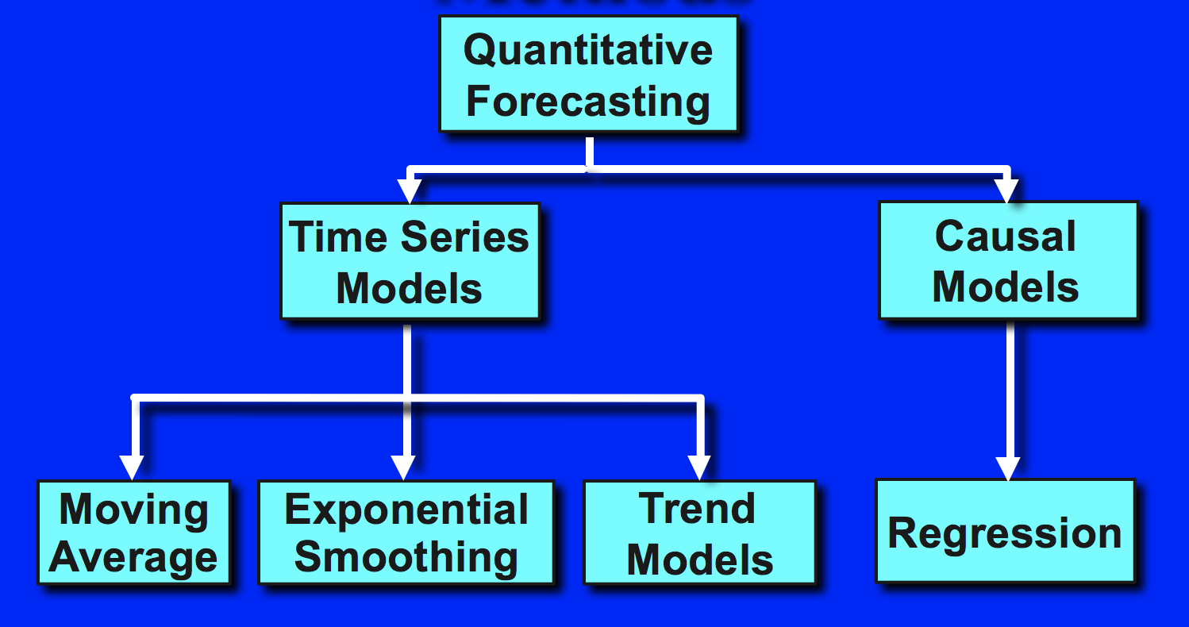
Quantitative Forecasting Approach

Slide 10
Time Series Techniques
So Time Series is a set of evenly spaced numerical data obtained by observing response variable at regular time periods.
There are many methods used to model and forecast time series:
- Box-Jenkins ARIMA models (Autoregressive Integrated Moving Average)
- Box-Jenkins Multivariate Models
- Holt-Winters Exponential Smoothing (single, double, triple)

Slide 11
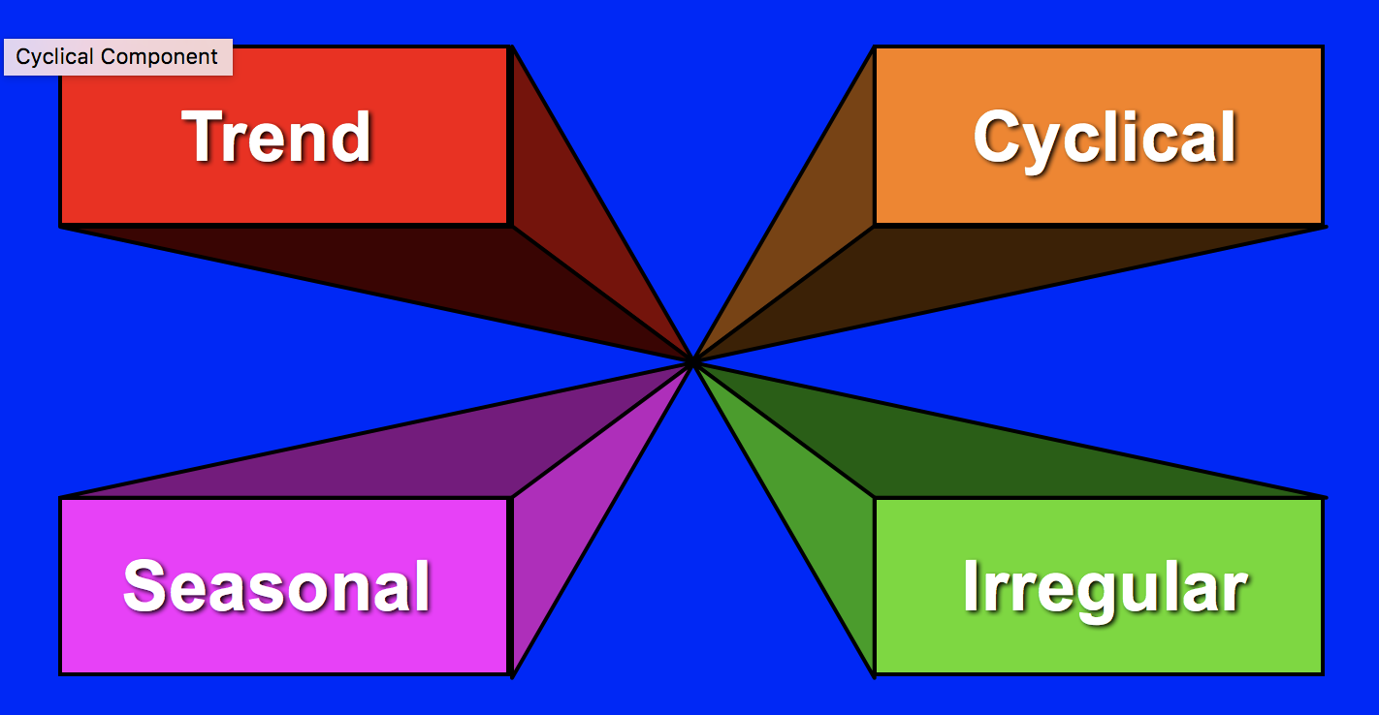
Time Series Components
Components

Slide 12
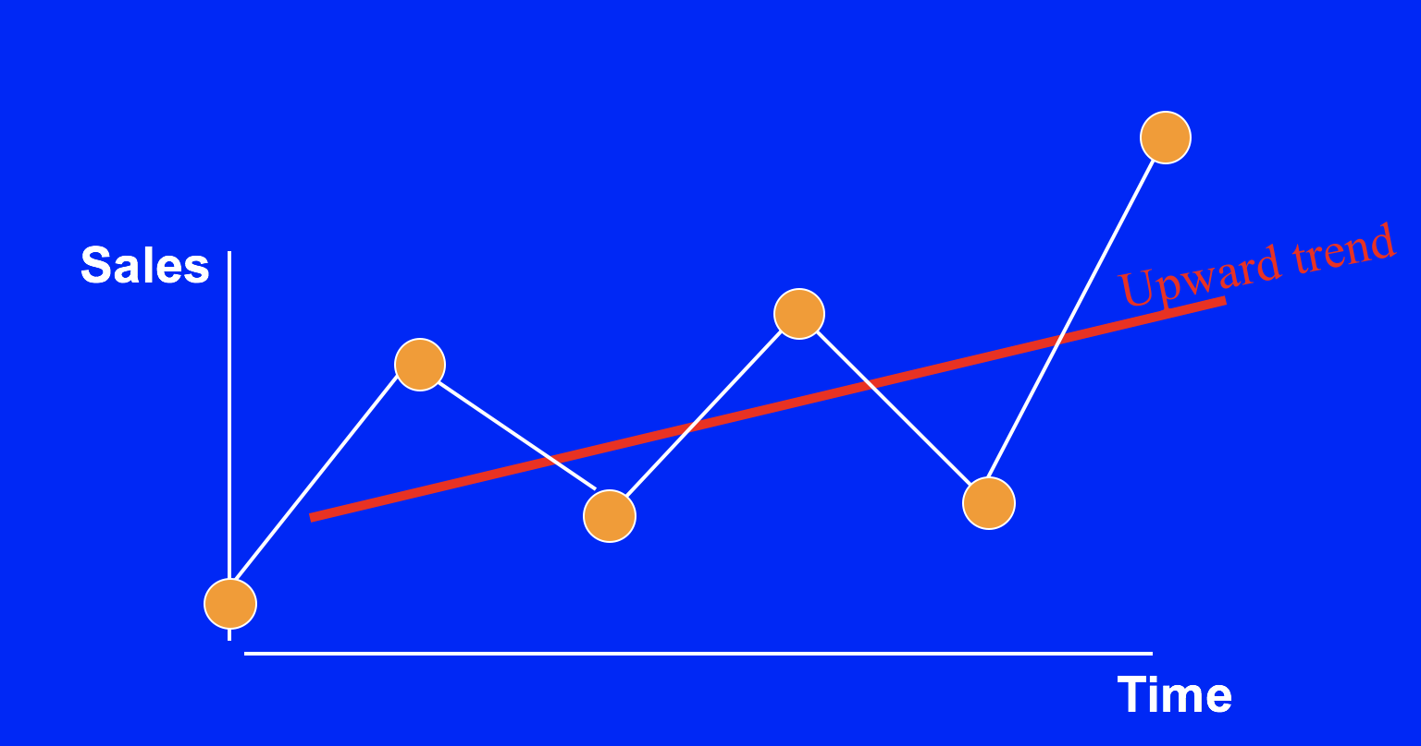
Time Series Components (trend)
Trends are persistent patterns in the data due to certain factors, observed over certain duration of time (usually years).

Slide 13
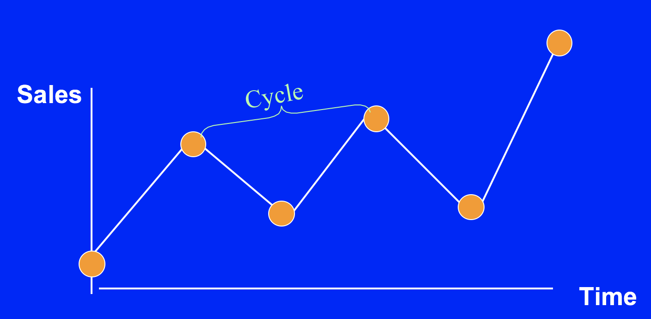
Time Series Components (cycle)
Cycles are repeating movements due to interactions of certain factors over a certain period of time (usually years).

Slide 14
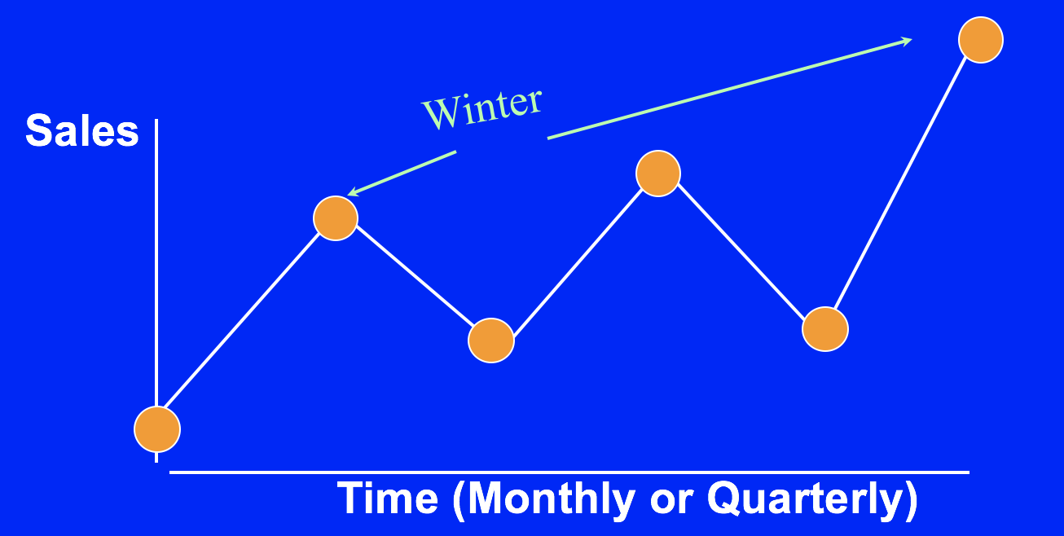
Time Series Components (seasonal)
Seasons are regular patterns of certain fluctuations due to weather or customs that occur within one year.

Slide 15
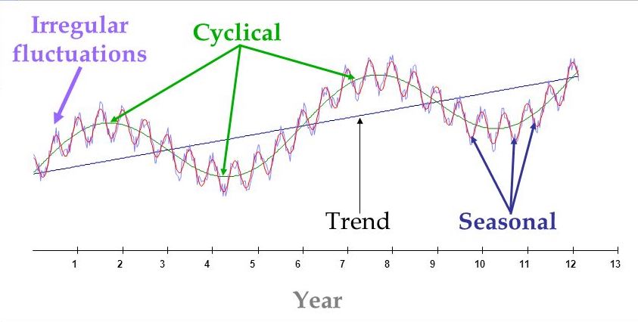
Time Series Components (seasonal)
Irregularity is erratic, unsystematic, residual fluctuations due to random variation or unforeseen events (e.g., war, employee strike, natural disaster, government shutdown) that lasts a short period of time and tends not to repeat.

Slide 16
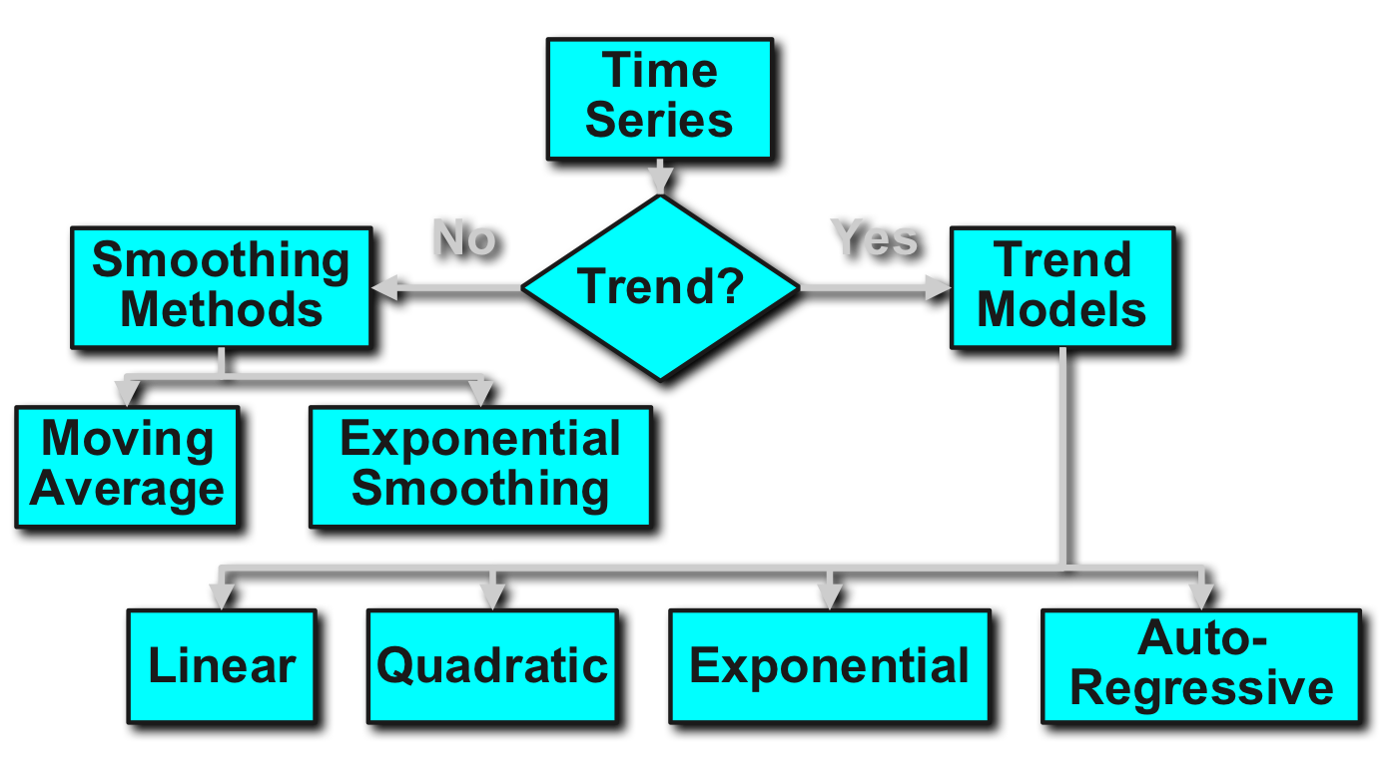
Time Series Forecasting

Slide 17
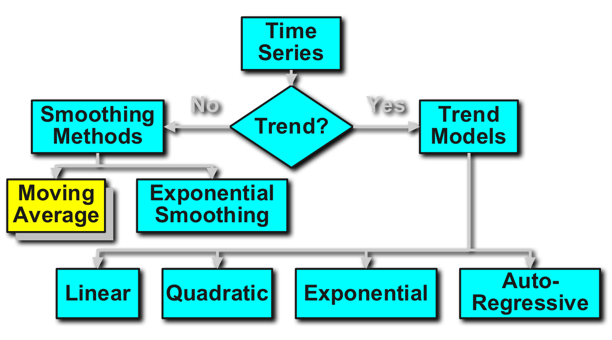
Intro to Averaging Method
Averaging Method uses series of means to provide an overall impression of data over time. Taking averages is the simplest way to smooth data and it is used for simple forecasting. There are more average methods than just moving:

Slide 18
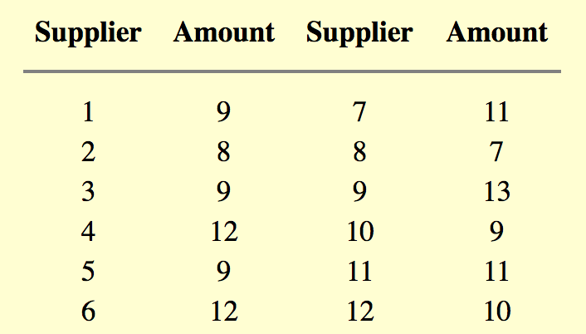
Simple Averaging Methods Example
For example, a manager of a warehouse wants to know how much a typical supplier delivers. She takes a sample of 12 suppliers, at random, obtaining the following results:

Slide 19
Simple Averaging Methods
The computed mean or average of the data = 10. Is this a good or bad estimate? To check we need to calculate the sum of squared error (SSE) and then the mean squared error (MSE).
* The "error" = true amount spent minus the estimated amount.
* The "error squared" is the error above, squared.
* The "SSE" is the sum of the squared errors.
* The "MSE" is the mean of the squared errors.
Results show SSE = 36 and the MSE = 36/12 = 3, when Mean = 10.

Slide 20
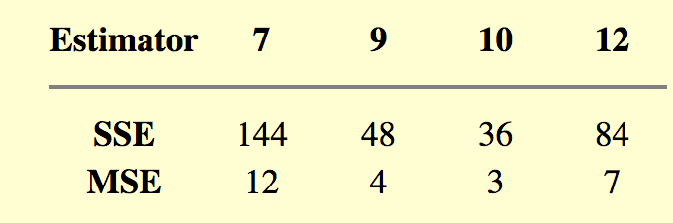
Simple Averaging Methods (cont)
So how good was the estimator for the amount spent for each supplier? Let us compare the estimate (10) with the following estimates: 7, 9, and 12.
The estimator with the smallest MSE is the best.

Slide 21
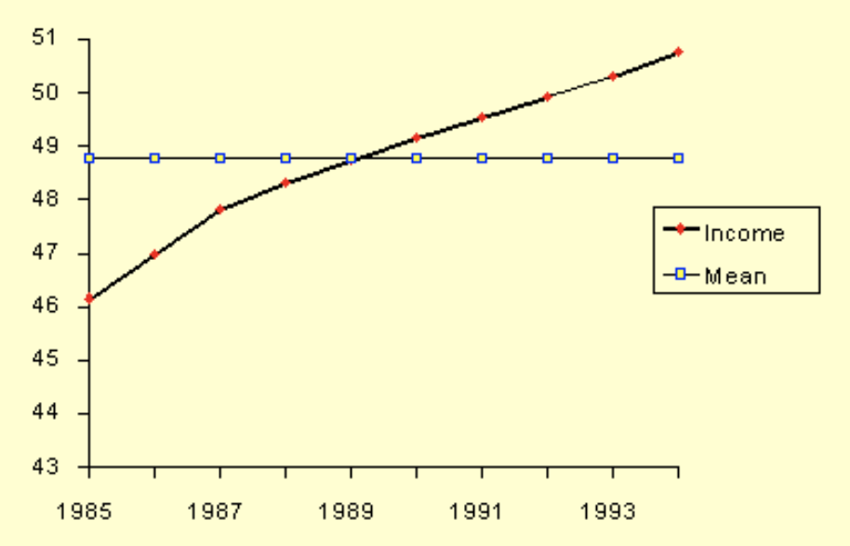
Simple Averaging Methods (cont)
The question arises: can we use the mean to forecast things if we suspect a trend? A look at the graph below shows clearly that we should not do this.
The "simple" average or mean of all past observations is only a useful estimate for forecasting when there are no trends. If there are trends, use different estimates that take the trend into account. The reason is that average "weights" all past observations equally.

Slide 22
Simple Moving Average
An alternative way to summarize the past data is to compute the mean of smaller successive sets of numbers of past data as follows. This is called Moving Average. From our previous example, M is the size of the "smaller set" and it's equal to 3. Hence, the average of the first 3 numbers is:
(9 + 8 + 9) / 3 = 8.667

Slide 23
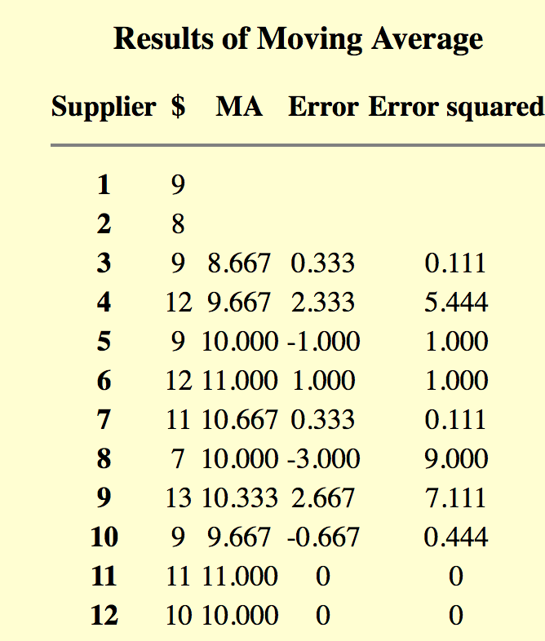
Simple Moving Average
This is called "smoothing". This smoothing process is continued by advancing one period and calculating the next average of three numbers, dropping the first number.

Slide 24
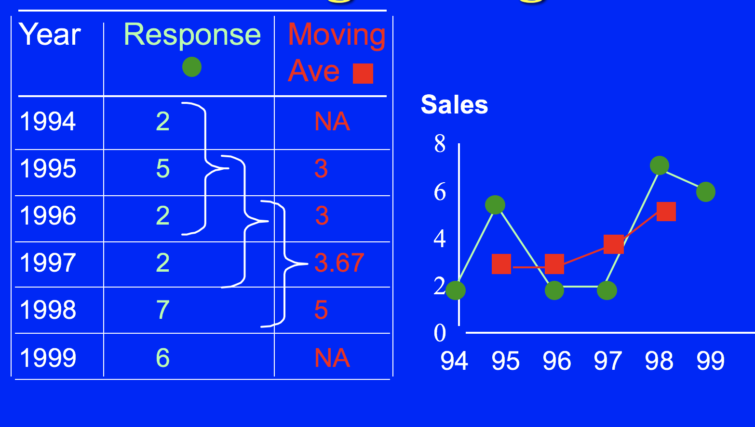
Plotting Simple Moving Average

Slide 25
Centered Moving Average
In the previous example we computed the average of the first 3 time periods and placed it next to period 3. We could have placed the average in the middle of the time interval of three periods, that is, next to period 2.
This works well with odd time periods, but not so good for even time periods. So where would we place the first moving average when M = 4?
The Moving Average would fall at t = 2.5, 3.5, ... in the interin step and would be smoothed to 3, 4, ... in the final step with additional averaging.

Slide 26
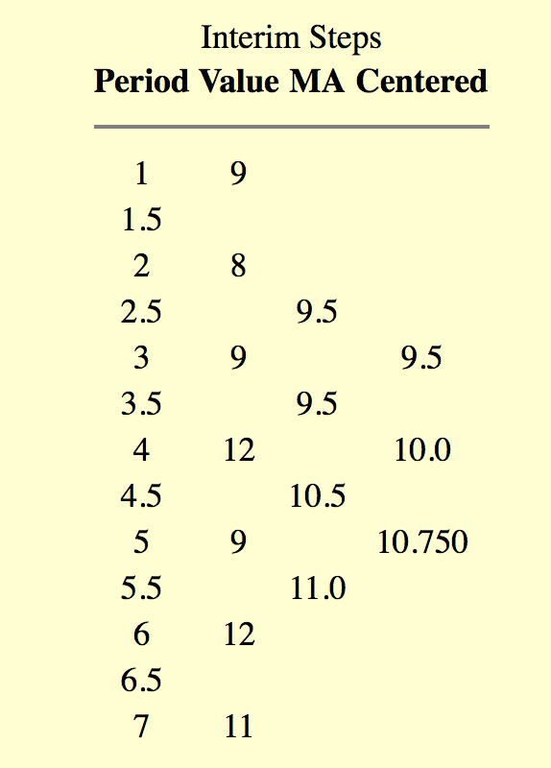
Centered Moving Average (cont)

Slide 27
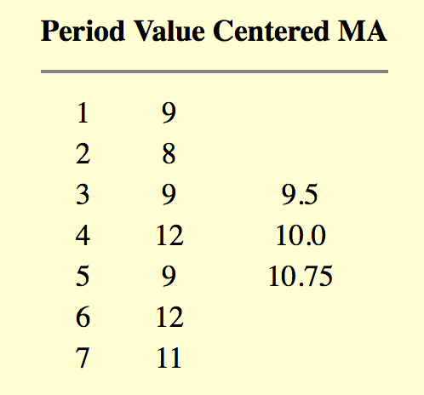
Centered Moving Average (cont)
Unfortunately, neither the mean of all data nor the moving average of the most recent M values, when used as forecasts for the next period, are able to cope with a significant trend.

Slide 28
Exponential Smoothing
Whereas in Single Moving Averages the past observations are weighted equally, Exponential Smoothing assigns exponentially decreasing weights as the observation get older.
In other words, recent observations are given relatively more weight in forecasting than the older observations.
In exponential smoothing, there are one or more smoothing parameters to be determined (or estimated) and these choices determine the weights assigned to the observations.
There is **single**, **double**, and **triple** exponential smoothing approaches. It is called exponential b/c weights decline exponentially.

Slide 29
Single Exponential Smoothing
* It begins by setting S_2 to y_1, where S_i stands for smoothed observation (EWMA), and **y** stands for the original observation, while subscripts refer to the time periods 1, 2,...n.
* For forecasting for the third period, we would use the following:
S_3=α*y_2+ (1−α)*S_2;
and so on forecasting for the rest of the periods.

Slide 30
Single Exponential Smoothing (cont)
There is no S_1; the smoothed series starts with the smoothed version of the second observation.
This is the basic version of exponential smoothing and **α** is called the smoothing constant and is set between 0 and 1, while **t** >= 3.
* The initial S_i plays an important role in computing all the subsequent S_i’s. Setting S_2 to y1 is one method of initialization. Another possibility would be to average the first four or five observations. There are other approaches and it would be wise to compute several and compare.

Slide 31
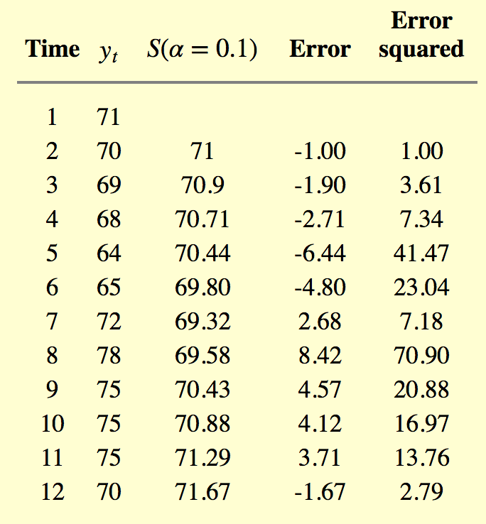
Single Exponential Smoothing Example

Slide 32
What is the best value of α?
The speed at which the older responses are smoothed is a function of the value of **α**. When **α** is close to 1, smoothing is quick and when **α** is close to 0, smoothing is slow.
* 0.1*70+(1-0.1)*71 = 70.9
* 0.1*69+(1-0.1)*70.9 = 70.71
* SSE = 208.94.
* MSE = SSE/11 = 19.0

Slide 33
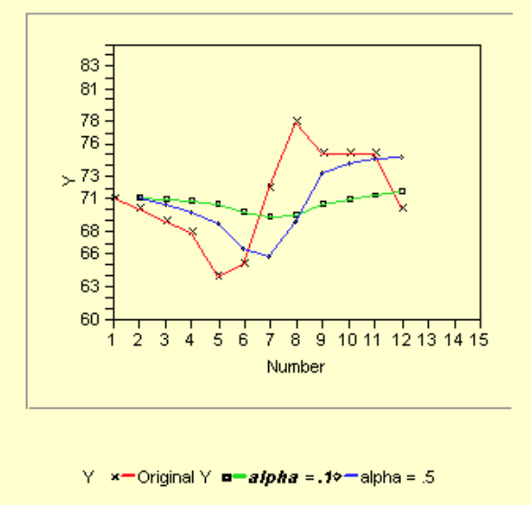
Can we do better?
The MSE was again calculated for α=0.5 and turned out to be 16.29, so in this case we would prefer an α of 0.5. We can repeat this trial-and-error process until we find the best MSE. We could also try Marquardt procedure to find the minimum MSE.

Slide 34
Forecasting with Single Exponential Smoothing
Our smoothing formula is:
S_t+1=α*y_t+(1−α)*S_t,
where **0<α≤1** and **t>0**
It can be rewritten as:
S_t+1=S_t+αϵ_t**
where **ϵ_t** is the forecast error (actual - forecast) for period t
So basically, the new forecast is the old one plus an adjustment for the error that occurred in the last forecast.
In case you wish to forecast data where no actual observations are available then you use **y_origin** which stays constant. This is called bootstrapping.
Single Exponential Smoothing is not very good when there is a trend. The single coefficient **α** is not enough.

Slide 35
Stationary Data
Before we move onto the modeling, let's quickly touch on time series data.
A common assumption in many time series techniques is that the data are stationary. A stationary process has the property that the mean, variance and autocorrelation structure do not change over time. This means, a flat looking series, without trend, constant variance over time, a constant autocorrelation structure over time and no periodic fluctuations (seasonality). A stationarized series is relatively easy to predict: you simply predict that its statistical properties will be the same in the future as they have been in the past!
If the time series is not stationary, we can often transform it to stationarity with one of the following techniques.
* We can difference the data. That is, given the series Z_t, we create the new series where Y_i = Z_i - Z_i-1. The differenced data will contain one less point than the original data. Usually this is sufficient.
* For non-constant variance, taking the logarithm or square root of the series may stabilize the variance.
* If the data contain a trend, we can fit some type of curve to the data and then model the residuals from that fit.

Slide 36
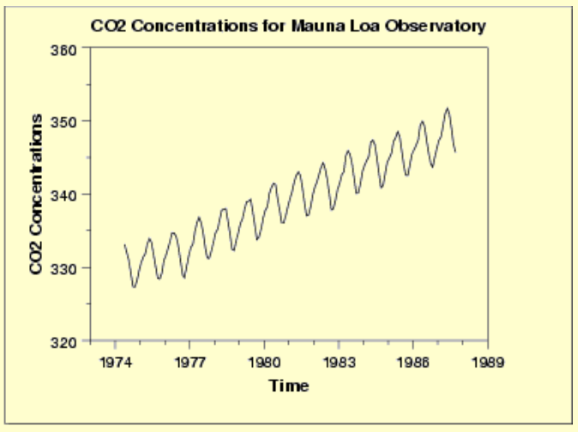
Example of Stationarity
The following plot indicates a rising trend in the data.

Slide 37
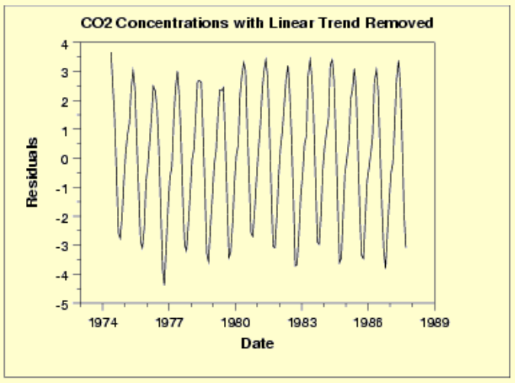
Example of Stationarity (cont)
Simple linear fit removes the upward trend.

Slide 38
Example of Stationarity (cont)
This plot contains the residuals from a linear fit to the original data. After removing the linear trend, the data has a constant location and variance, although the pattern of the residuals shows that the data depart from the model in a systematic way.
We can also use Augmented Dickey_Fuller Test (**adf.test()** from **tseries** library) to test whether time series is stationary or not. If the p-value is below 0.05, the time series is considered to be stationary.

Slide 39
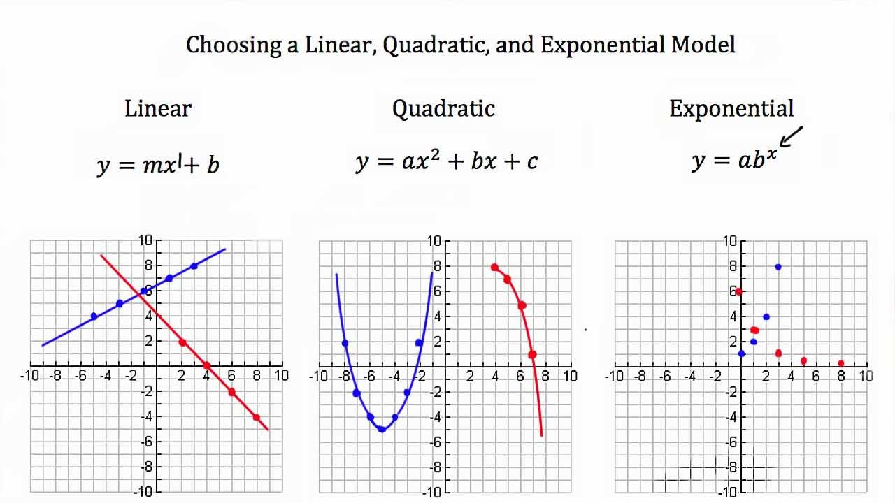
Comparison Between Models
Before we discuss the following three models for time series analysis, just a quick reminder:

Slide 40
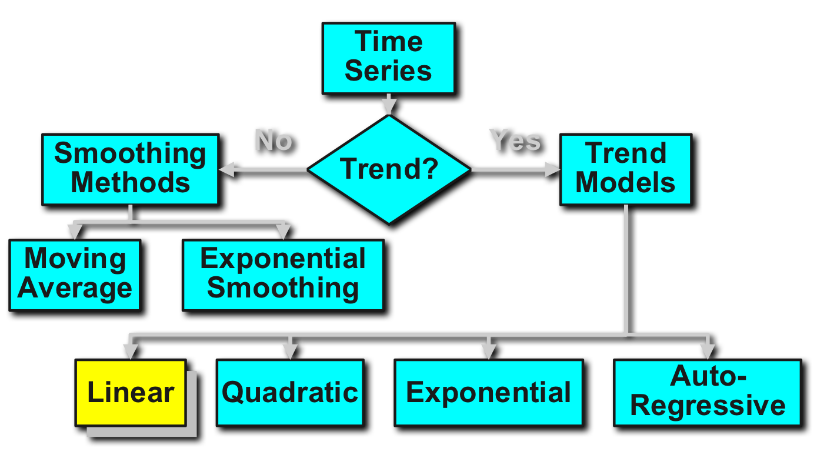
Linear Time-Series Forecasting Model

Slide 41
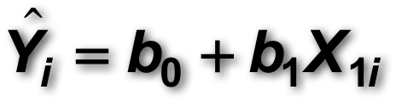
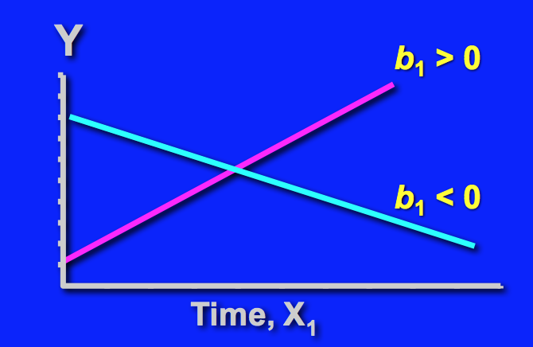
Linear Time-Series Forecasting Model
This model is used when forecasting a trend where the relationship between response variable (Y) and the predictor variable (X) is a linear function. Usually X gets coded into numbers to make the prediction easier but this is not required.

Slide 42
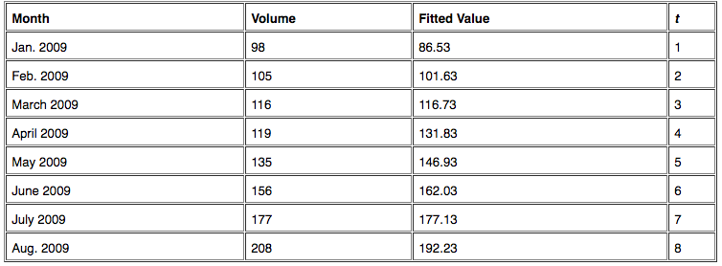
Linear Time-Series Forecasting Model Example
First step is to plot the data using linear trend analysis. The software will use the earlier mentioned equation to get for following:
Yt = 71.43 + (15.1 x t)

Slide 43
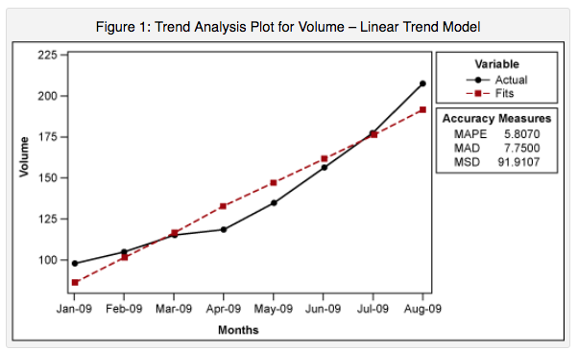
Linear Time-Series Forecasting Model Example (cont)
But how did we get the constants? It's a simple linear regression by plugging in the volume for Y and 1,2,3,..n for X and solving for the constants.

Slide 44
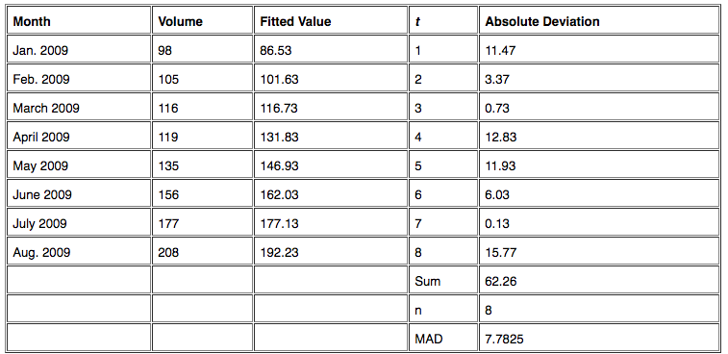
Forecast Accuracy Measures
These measures are used to determine how well the trend will accurately predict the future volume.
* MAD - mean absolute deviation, which is the average of the absolute deviations.

Slide 45
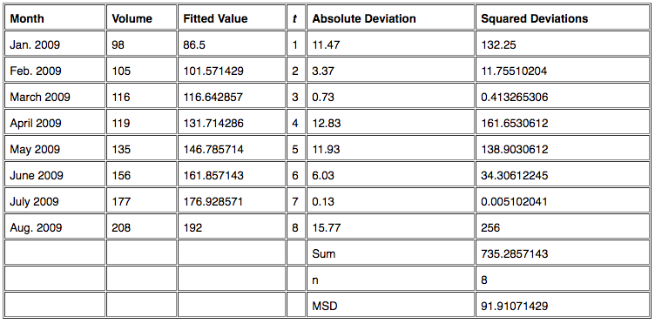
Forecast Accuracy Measures
* MSD - mean square deviation. It is very similar to MAD, but instead of summing the absolute deviations, this measure sums up the squared deviations and gets the mean.
MSD is more preferred than MAD.

Slide 46
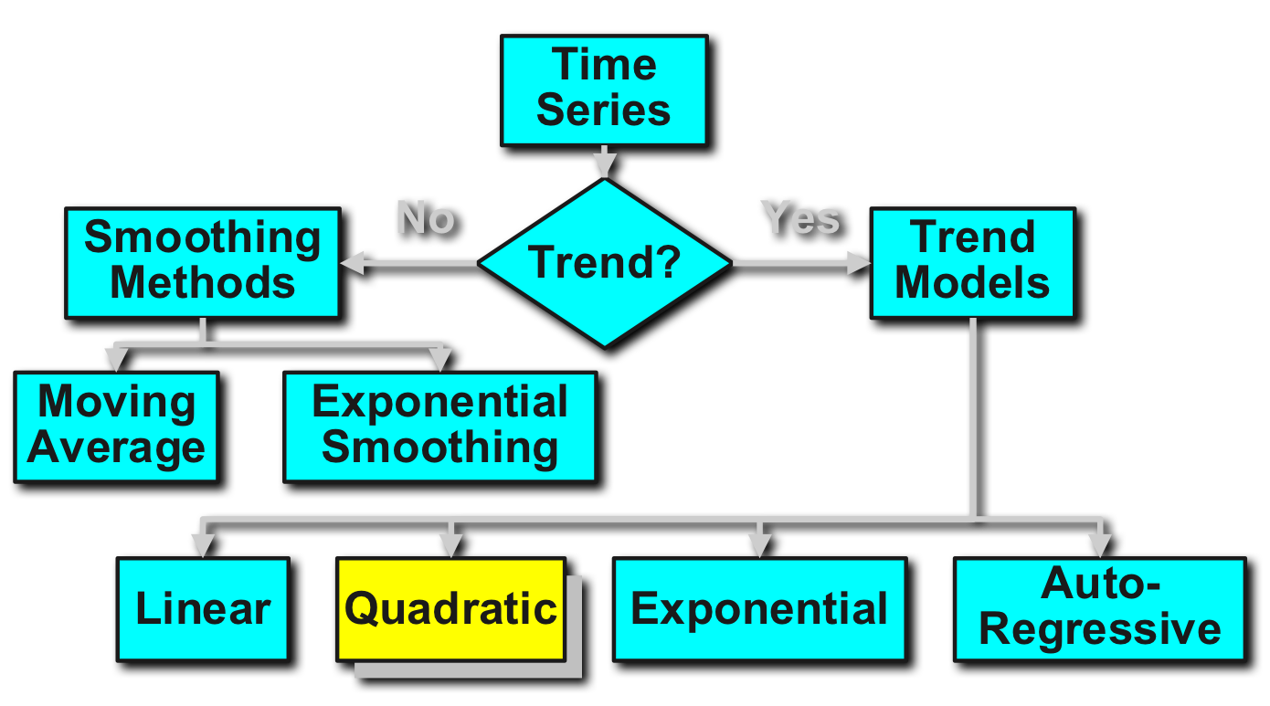
Quadratic Time Series Model

Slide 47
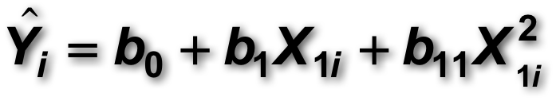
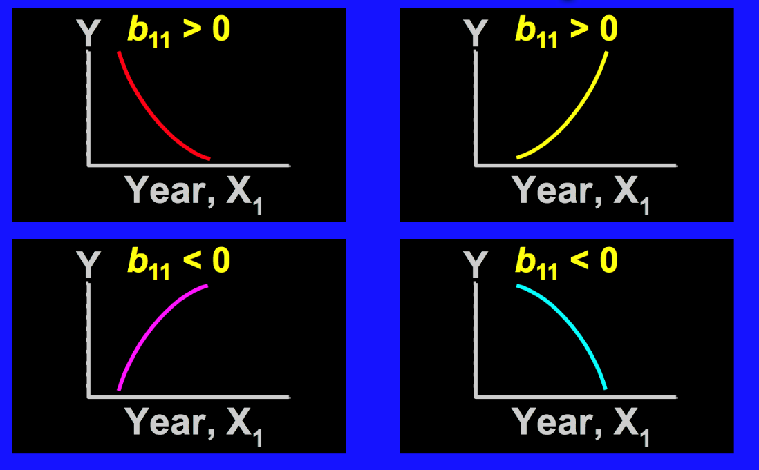
Quadratic Time Series Model
If you assume that the trend in the data is quadratic and not linear (meaning in this example the volume is increasing at a faster rate than it would with linear proportion) then we can use quadratic trend analysis.

Slide 48
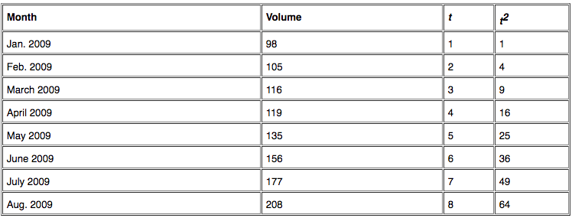
Quadratic Time Series Model
The equation used with the quadratic trend is **Yt = 101.61 – (3.04 x t) + (2.012 x t2)**, Once again, this equation is reached through regression analysis. To find these constants, we need to use t^2. We would use the same MAD and MSD to check the model accuracy.

Slide 49
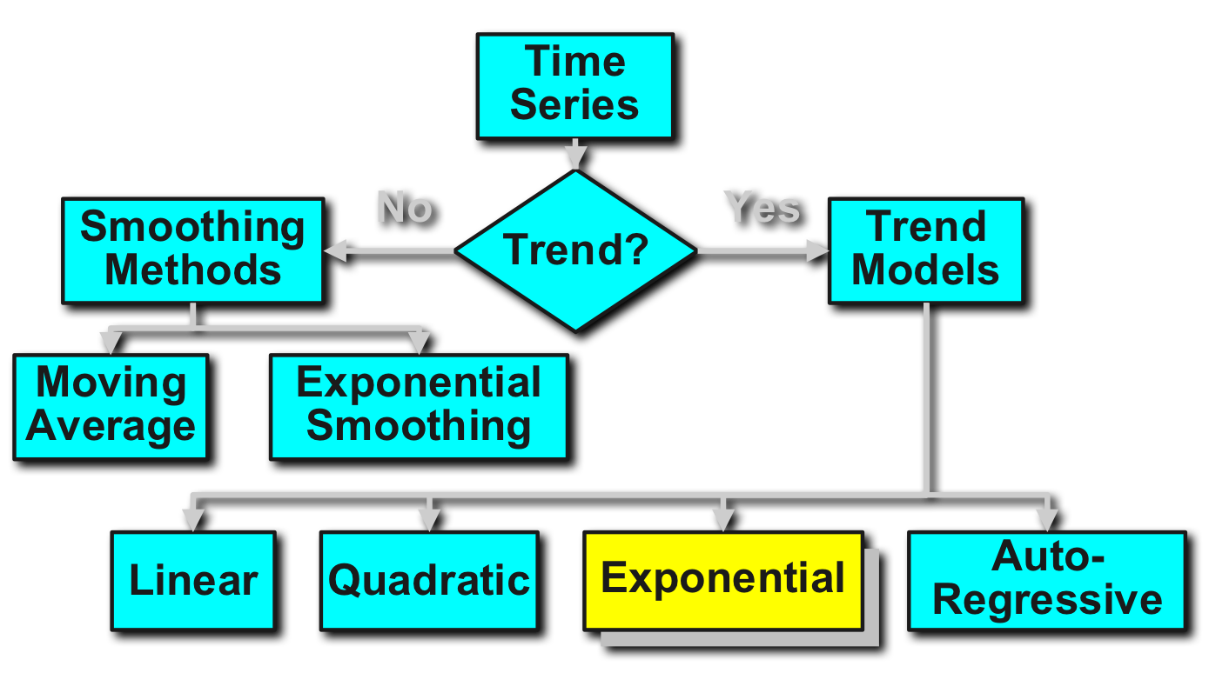
Exponential Model

Slide 50
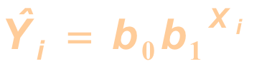
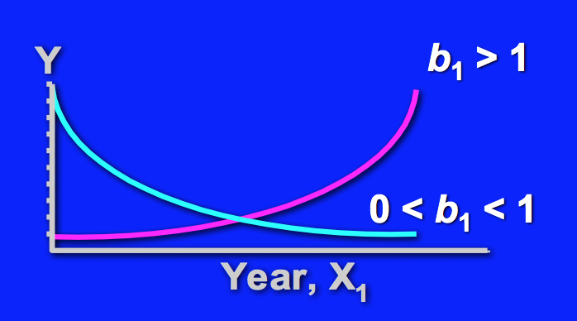
Introduction to Exponential Model
Used for forecasting, this model assumes that the relationship between the Y and X is an exponential function. Aka, series increases (decreases) at increasing (decreasing) rate.

Slide 51
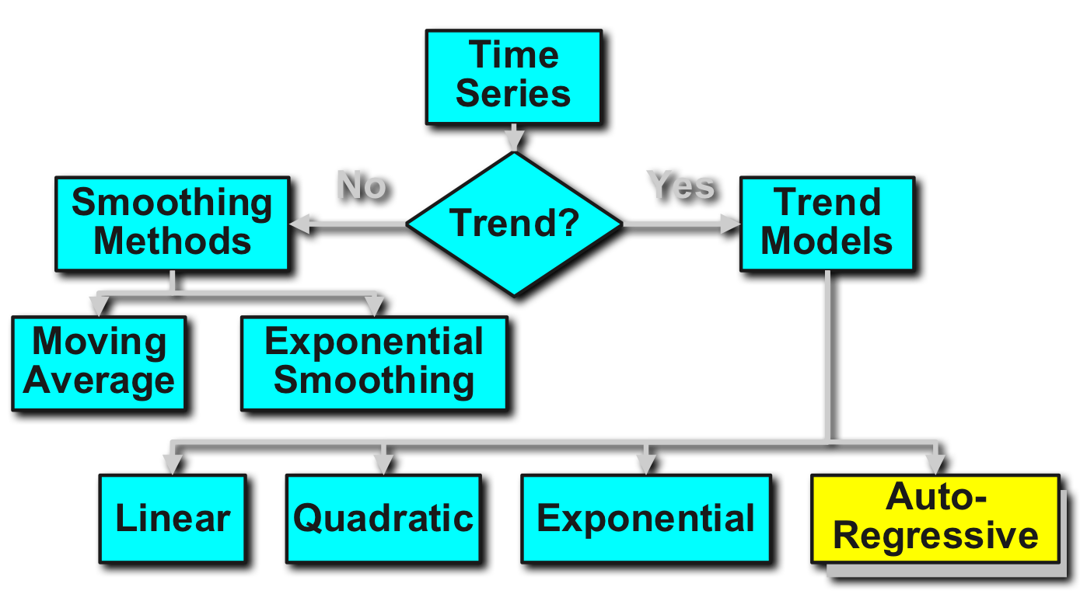
Autoregressive Integrated Moving Average (ARIMA) Model

Slide 52
ARIMA Model
ARIMA is the Integrated (non-stationary data differenced into stationary) version of ARMA model.
AR model is simply a linear regression of the current value of the series against one or more prior values of the series. The value of p is called the order of the AR model.
Another common approach for modeling time series is the moving average (MA) model. The moving average model is conceptually a linear regression of the current value of the series against the white noise or random shocks of one or more prior values of the series. The value of q is called the order of the MA model.

Slide 53
ARIMA Model
Generally the acronym ARIMA is used instead. The model captures a suite of different standard temporal structures in time series data. This acronym is descriptive, capturing the key aspects of the model itself:
* **AR (p) - Autoregression**. A model that uses the dependent relationship between an observation and some number of lagged observations.
* **I (d) - Integrated**. The use of differencing of raw observations (e.g. subtracting an observation from an observation at the previous time step) in order to make the time series stationary.
* **MA (q) - Moving Average**. A model that uses the dependency between an observation and a residual error from a moving average model applied to lagged observations.
Each of these components are explicitly specified in the model as a parameter. A standard notation is used of ARIMA(p,d,q) where the parameters are substituted with integer values to quickly indicate the specific ARIMA model being used.

Slide 54
ARIMA Model
The parameters of the ARIMA model are defined as follows:
* **p**: The number of lag observations included in the model, also called the lag order.
* **d**: The number of times that the raw observations are differenced, also called the degree of differencing.
* **q**: The size of the moving average window, also called the order of moving average.
A value of 0 can be used for a parameter, which indicates to not use that element of the model.
A linear regression model is constructed including the specified number and type of terms, and the data is prepared by a degree of differencing in order to make it stationary, i.e. to remove trend and seasonal structures that negatively affect the regression model.

Slide 55
ACF and PACF
Autocorrelation plot and the partial autocorrelation plot are used to identify the values for AR(p) and (MA)q. This is used to determine whether AR or MA terms are needed to correct any autocorrelation that remains in the differenced series.
ACF plot it is a bar chart of the coefficients of correlation between a time series and lags of itself. The PACF plot is a plot of the partial correlation coefficients between the series and lags of itself.
For an AR(1) process, the sample autocorrelation function should have an exponentially decreasing appearance.
The autocorrelation function of a MA(q) process becomes zero at lag q+1 and greater, so we examine the sample autocorrelation function to see where it essentially becomes zero.

Slide 56
Autocorrelation Table
Exponential, decaying to zero **->** Autoregressive model. Use the partial autocorrelation plot to identify the order of the autoregressive model.
Alternating positive and negative, decaying to zero **->** Autoregressive model. Use the partial autocorrelation plot to help identify the order.
One or more spikes, rest are essentially zero **->** Moving average model, order identified by where plot becomes zero.
Decay, starting after a few lags **->** Mixed autoregressive and moving average model.
All zero or close to zero **->** Data is essentially random.
High values at fixed intervals **->** Include seasonal autoregressive term.
No decay to zero **->** Series is not stationary.

Slide 57
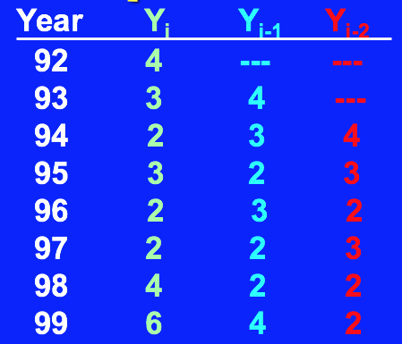
Simple Example or 2nd Order ARIMA
A Corporation has acquired a number of office units (in sqft) over the last 8 years. Develop the 2nd order Autoregressive models.
* First, develop the 2nd order table
* Then run a regression model

Slide 58
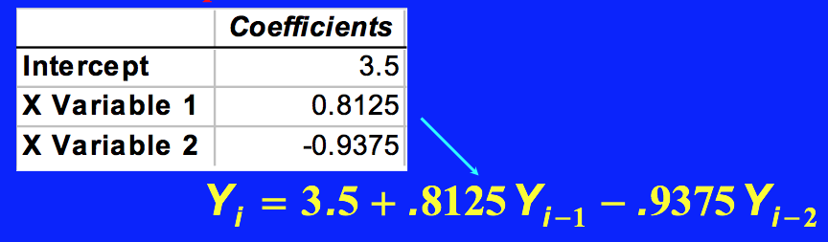
Simple Example or 2nd Order ARIMA

Slide 59
ARIMA Step 1 Visualize the Time Series
It is essential to analyze the trends prior to building any kind of time series model. The details we are interested in pertains to any kind of trend, seasonality or random behavior in the series.
>>>adf.test(diff(log(AirPassengers)), alternative="stationary", k=0)

Slide 60
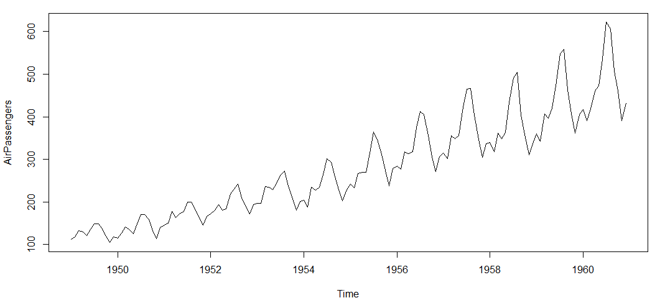
ARIMA Step 1 Observations
* There is a trend component which grows the passenger year by year.
* There looks to be a seasonal component which has a cycle less than 12 months.
* The variance in the data keeps on increasing with time

Slide 61
ARIMA Step 1 Observations
We know that we need to address two issues before we test stationary series.
* we need to remove unequal variances. We do this using log of the series.
* we need to address the trend component. We do this by taking difference of the series.
Now, let’s move to step 2.

Slide 62
ARIMA Step 2: Stationarize the Series
Once we know the patterns, trends, cycles and seasonality , we can check if the series is stationary or not. Dickey – Fuller is one of the popular test to check the same. If the series is found to be non-stationary:
detrending: we simply remove the trend component from the time series
differencing: compute the differences between consecutive observations and model the differences instead of the actual terms.
seasonality: seasonality can easily be incorporated in the ARIMA model directly.

Slide 63
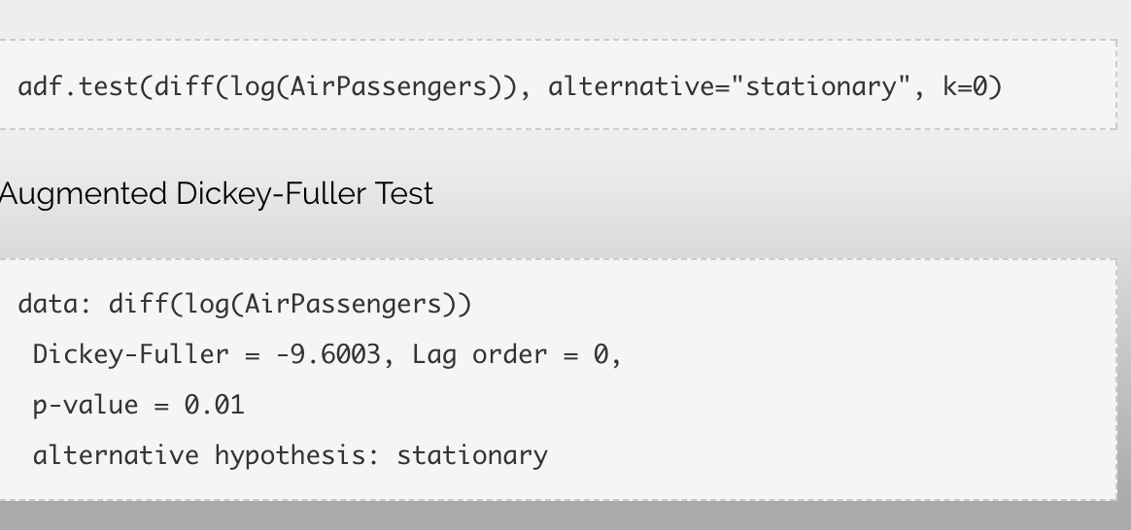
ARIMA Step 2: Observations
We see that the series is stationary enough to do any kind of time series modelling.

Slide 64
ARIMA Step 3: Find Optimal Parameters
The parameters p,d,q can be found using ACF and PACF plots. If both ACF and PACF decreases gradually, it indicates that we need to make the time series stationary and introduce a value to “d” (1). Sometimes ACF and PACF will suggest that a MA model would be a better model choice and sometimes both AR and MA terms should be used in the same model.
>>> acf(diff(log(AirPassengers)))
>>> pacf(diff(log(AirPassengers)))

Slide 65
Exploring ACF and PACF plots
Once we have got the stationary time series, we must answer two primary questions:
* Is it an AR or MA process?
* What order of AR or MA process do we need to use?
The first question can be answered using Total Correlation Chart (also known as Auto – correlation Function / ACF). ACF is a plot of total correlation between different lag functions (correlation of x(t) with x(t-1) , x(t-2) and so on).
For an MA series (looking at ACF), if the total correlation chart cuts off at nth lag, our lag is nth for MA series. However, if the correlation gradually goes down without a cutoff, we need have MA(0).

Slide 66
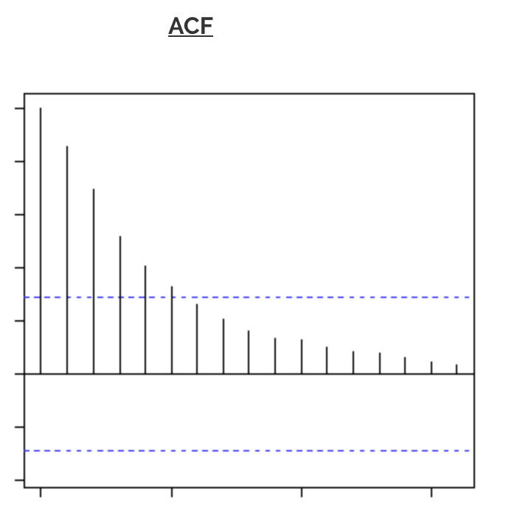
Exploring ACF and PACF plots
If we had this graph for ACF, we would have MA(0). 0 denotes that the next instance is independent of the previous instances.

Slide 67
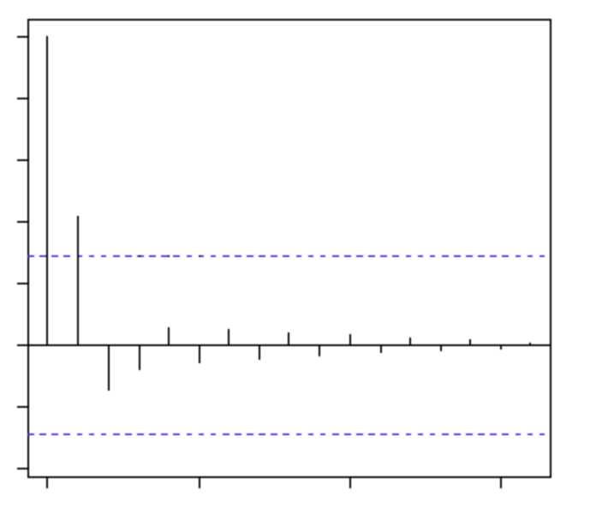
Exploring ACF and PACF plots
If we had this graph for PACF, we would have AR(2). 2 denotes that the next instance is solely dependent on the previous two instances.

Slide 68
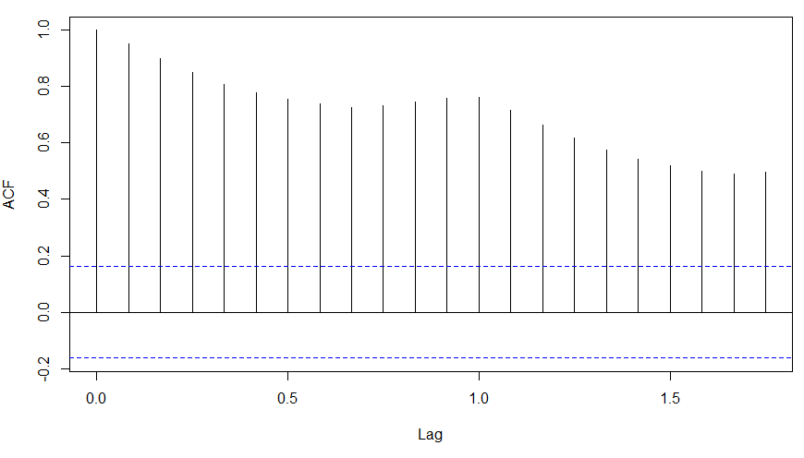
ARIMA Step 3: Observations
We already knew that the ‘d’ component is 1 as we need 1 difference to make the series stationary.
The decay of ACF chart is very slow, which means that the population is not stationary. We now have to regress on the difference of logs rather than log directly.

Slide 69
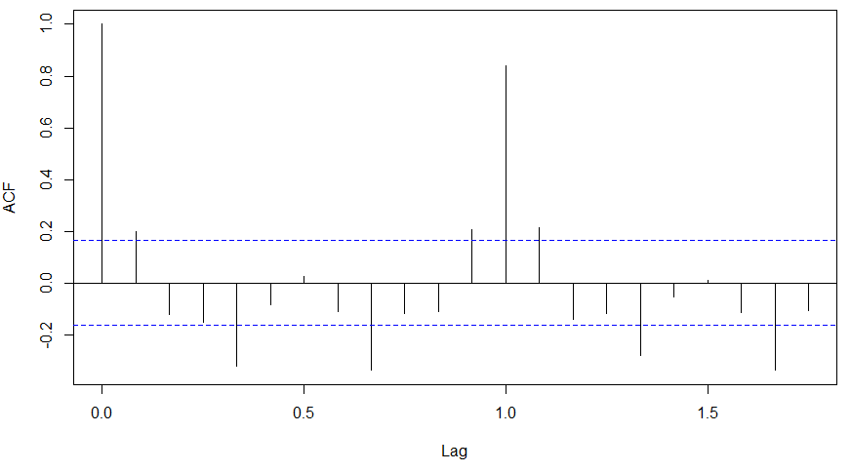
ARIMA Step 3: Observations
ACF plot cuts off after the first lag. Hence, that value of p should be 0 as the ACF is the curve getting a cut off. While value of q should be 1 or 2. We can use both and check AIC and BIC for the final values. We go wtih (0,1,1) as (p,d,q) as that comes out to be the combination with least AIC and BIC.

Slide 70
ARIMA Step 4: Build the Model
With the parameters in hand, we can now try to build ARIMA model. The value found in the previous section might be an approximate estimate and we need to explore more (p,d,q) combinations. The one with the lowest BIC and AIC should be our choice.
>>> (fit <- arima(log(AirPassengers), c(0, 1, 1),seasonal = list(order = c(0, 1, 1), period = 12)))

Slide 71
ARIMA Step 5: Make Predictions
Once we have the final ARIMA model, we are now ready to make predictions on the future time points. We can also visualize the trends to cross validate if the model works fine.
>>> pred <- predict(fit, n.ahead = 10*12)
>>> ts.plot(AirPassengers,2.718^pred$pred, log = "y", lty = c(1,3))

Slide 72
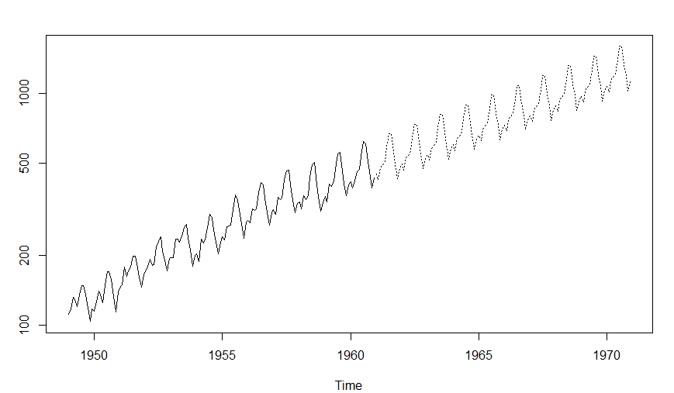
ARIMA Step 5: Observations

Slide 73
ARIMA Example in R
please READ and follow this example
https://www.datascience.com/blog/introduction-to-forecasting-with-arima-in-r-learn-data-science-tutorials

Slide 74
Evaluating Forecasting
The model with the following is the best:
* No pattern or direction in forecast error. This means the error in the forecasted Y_i from Actual Y_i is not in any particular pattern or direction.
* Smallest forecast error. This is measured by mean absolute deviation.
* Simplest model. This is called the principle of parsimony.

Slide 75
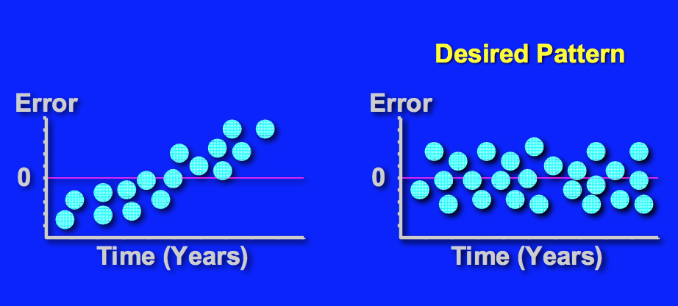
Evaluating Forecasting: Error Pattern

Slide 76
Evaluating Forecasting: Principle of Parsimony
If two or more models provide good fit for data, select the simplest model.
* Simplest model types:
* least_square linear
* least_square quadratic
* 1st order autoregressive
* Complex model types:
* 2nd or 3rd order autoregressive
* least squares exponential.

Slide 77
Practice Time Series Analysis
Read thoroughly and follow the example
http://r-statistics.co/Time-Series-Analysis-With-R.html

Slide 78
Week 5 Assignment
Please follow these instructions and submit your assignment including everything in ONE document (.doc/pdf). Don’t forget to explain your results.
Part (A): Using R to show how to decompose the seasonal time series data and then subtract that effect from the data.
This assignment is to practice using R to learn how to decompose seasonal time series data. Please use the data set in “A Little of R for Time Series” section 2.4 (p.20):
>births <- scan("http://robjhyndman.com/tsdldata/data/nybirths.dat")
>birthstimeseries <- ts(births, frequency=12, start=c(1946,1))
>birthstimeseries
Then you can use the following to show how you can decompose the time series and then subtract the seasonal effect from the data:
Use decompose() function for displaying decomposing seasonal time series as well as seasonally adjusting to subtract the seasonal components from the time series and give some insights to it.
Part (B): Using R to show how to address issues of correlations between successive values of the time series. In many cases you can make a better predictive model by taking correlations in the data into account. We use a technique in Statistics called Autoregressive Integrated Moving Average (ARIMA) models for this irregular component of a time series.
This assignment is to practice using R to address autocorrelation issues. Please use the data set in “A Little of R for Time Series” ARIMA Models in section 2.6 (pp.45-57), the following data set is in page
>volcanodust <- scan("http://robjhyndman.com/tsdldata/annual/dvi.dat", skip=1)
>volcanodustseries <- ts(volcanodust,start=c(1500))
Then you can use the following to show how you can decompose the time series and then subtract the seasonal effect from the data:
Use acf(), pacf() and auto.arima() function show how to use R functions to address autocorrelation issues in data sets with insights.

Slide 79
Group Project Introduction
As the final assignment in this course, I want you all to be more creative, take some risks, and share a project. Therefore, please use at least one of the methods (i.e., Regression Analysis, Hypothesis Test, Regularization, Data Mining, and Time Series Analysis) we have learned from the first five modules to analyze a real world data of interest to you with a goal of solving a problem you pose. You may use the supporting links I posted in the module six supporting materials folder.
Please come up with some research questions based on the data you chose and apply the analytical methods you have learned in this course, covered in Modules 1-5. Please prepare a report based on your findings that will include the following information:
a cover page with all the student names in your group, course/section, institution, instructor's name, the assignment title, and the date, a section on the research questions, a section on the data set(s) chosen, a section on the method(s) chosen, a section on results & findings, a section on conclusions, references (if any)
appendix: your r script or your analyses document in any other format (excel, tableau, python, etc.)
email: each student in a group should email me 1-2 sentences on how they felt working in the group. I want to hear your reflection of the experience both good or bad.
You shall work in a group of two or three students at most (will be assigned). Your project should follow APA format, however, i won't be posing any page limitations but I expect thorough report. Please approach this as your chance to investigate something of interest to you. You should include images, graphs, figures, charts, and tables as necessary. The deadline will be the last day of class.
If you have any questions, please contact me. However, do not wait until the last day of the assignment's due date to email me with questions/concerns. Start working on it as soon as you can to have a higher chance of success.
This report is due Friday, May 18th but will be presented in class Wednesday, May 16th
I look forward to seeing your creative and analytical work. I know if you put in the effort, you can have some very fascinating results. Work hard!

